Slide 1

INTERNSHIP PROJECT REPORT
TITLE- EMPLOYEE ATTRITION ANALYSIS
NAME-MUKESH J
BATCH -1
www.sadhvisoft.com ©2023 Sadhvisoft Copyright

Slide 2
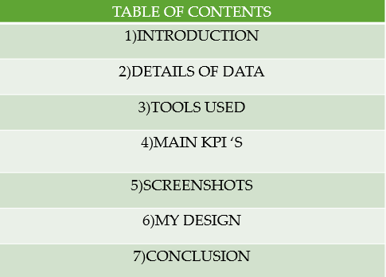

Slide 3
INTRODUCTION:
XYZ Company, established recently, grapples with a persistent 15% attrition rate over the past few years, significantly impacting various facets of the organization. To comprehend the reasons behind this trend and mitigate the attrition challenge, XYZ has enlisted the services of an HR analytics consultancy
The creation dashboard aims to empower the organization with actionable Insights derived from data analysis.

Slide 4
DETAILS OF DATA:
EDA PROJECTS WE WILL BE PERFORMING AMAZON SALES DATA ANALYSIS AND IT IS A INTERESTING DATASET TO WORK ON.
EXPLORE THE ATTRITION OF EMPLOYEE RATE OVER DIFFERENT TASK GIVEN IN THE TASK LIST.

Slide 5
TOOLS USED:
PANDAS
MATPLOTLIB
POWERBI

Slide 6
MAIN KPI’S USED:
ATTRITION BY GENDER
ATTRITION BY AGE
ATTRITION BY JOB LEVEL
ATTRITION BY DEPARTMENT
ATTRITION BY TOTAL WORKING YEARS
ATTRITION BY WORKING LIFE BALANCE

Slide 7
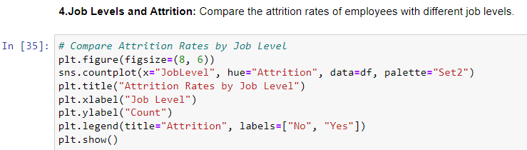
SCREENSHOTS:

Slide 8
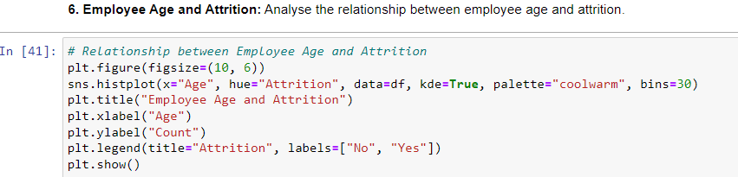
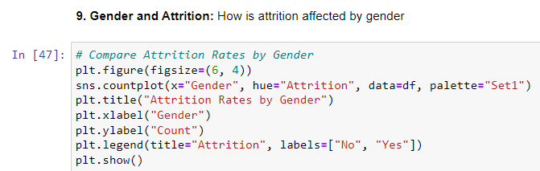
SCREENSHOTS:

Slide 9
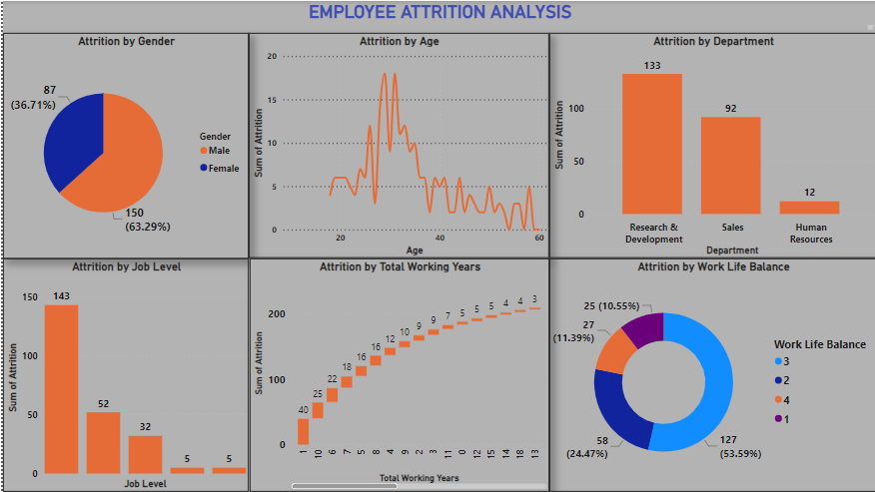
MY DESIGN:

Slide 10
CONCLUSION:
In conclusion, the methods employed in the data analysis of the given dataset were effective in providing insights into the data distribution.
The challenges encountered during the implementation of the methods provided valuable lessons for future works.

Slide 11
THANKYOU

